Slide 1
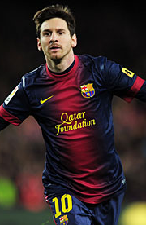
Principles of training
Lionel would like to start training for a marathon.
How does he know what to do?

Slide 2
Basic principles of training A.5
F.I.T.T principle
Frequency
Intensity
Time
Type

Slide 3
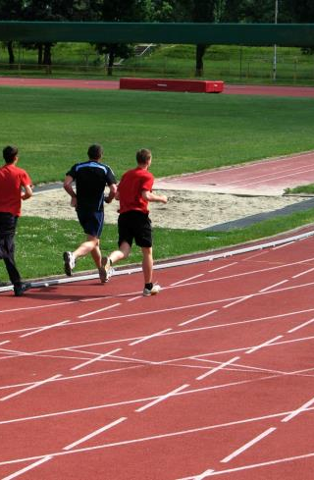
Frequency
Number of sessions per week
To improve general fitness, need to train 3-4 times per week

Slide 4
Intensity
How HARD the training is
Between 60 – 85% of your MHR
Training that is too easy won’t result in too many improvements

Slide 5
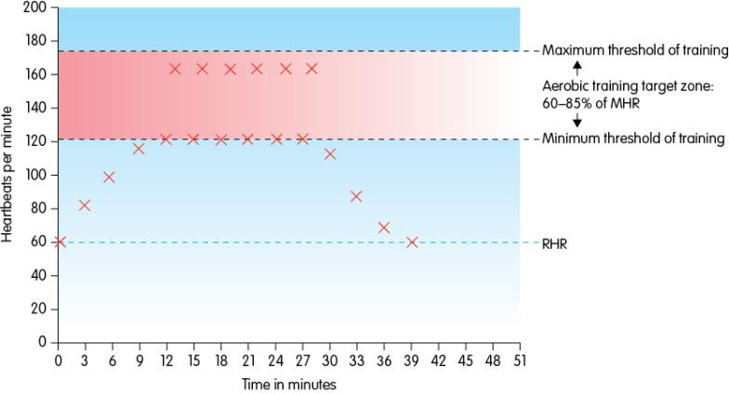
Question time:
What stage is the warm up? How long is he in the target zone? When does the cool down start? What is his resting hear rate? How long after exercise does it take to get back to the resting heart rate?

Slide 6

Time
Duration of the session
How LONG the session lasts
Depends upon the aims/goals of the performer. Typically for 20 minutes in your target zone

Slide 7
Type
The training method(s) that the athlete is using to improve fitness
Flexibility training
Strength, Muscular endurance and power training
Aerobic Endurance training
Speed training

Slide 8
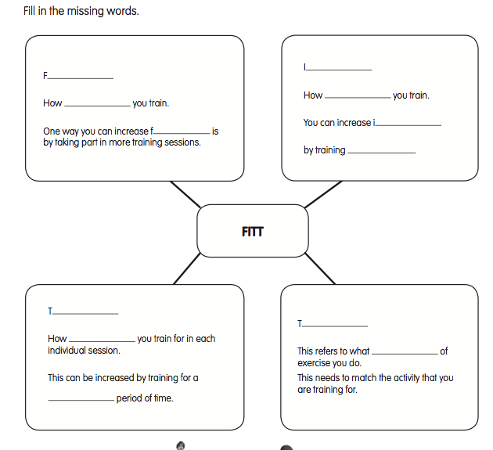

Slide 9
Review
Write a paragraph to explain how fitness levels can be improved using FITT for Lionel Messi, if he was training to take part in a marathon.

