Slide 1
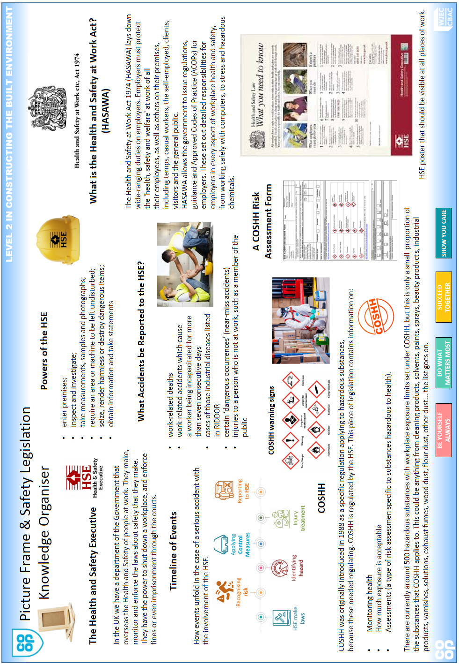

Slide 2
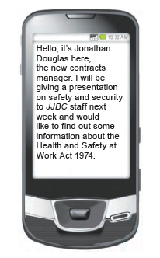
CO-OP ACADEMY FAILSWORTH LEVEL 2 IN CONSTRUCTING
THE BUILT ENVIRONMENT
CONSTRUCTION
ST ANNE’S ACADEMY LEVEL 2 IN CONSTRUCTING
THE BUILT ENVIRONMENT
Enquiry 3 Homework.
Health and Safety Legislation and the Role of The HSE
Using the Knowledge Organiser, answer the following 7 knowledge recall questions and the extended answer question below.
Knowledge Recall
What profession body are the HSE?
What is the purpose of the HSE?
Name 4 powers that the HSE have?
Name 4 different types of accident that should be reported to the HSE.
5 What does HASAWA stand for and what is it?
6 What does COSHH stand for and what is it?
7 What do they following COSHH warning signs mean?
Extended Answer Question
State three responsibilities under the Health and Safety at Work Act 1974 of:
(a) Employers [3 marks]
(b) Employeers [3 marks]
(Taken from the WJEC Constructing the Built Environment
Unit 1 Exam, Summer 2015. question 4(a) and 4 (b).

