Slide 1


Year 10 home learning booklet
Geography
Theme 1- Landscapes & physical processes
Parts 1 & 2- Distinctive landscapes and coasts (pt 1).

Slide 2
Contents
Page 3………………………………… Course spec and programme of study
Page 4………………………………… Lesson 1- Distinctive landscapes
Page 9………………………………… Lesson 2- What are Honeypot sites?
Page 14………………………………. Lesson 3- Introduction to Coasts
Page 19………………………………. Lesson 4- The discordant coastline
Page 23………………………………. Lesson 5- The concordant coastline

Slide 3
Welcome to GCSE Geography!
The specification that we will be following this year is
Eduqas GCSE Geography A.
This year, you will be focusing on UK human and physical geography, then moving on to add more detail to the hazards topic that we initially looked at in year 9. Fieldwork will take place this year and will be linked to Themes 1 and 2.
What will you study?
Year 10
Theme 1- Landscapes and Physical processes
Theme 2- Rural-urban links
Theme 3- Tectonic hazards
Theme 5- Weather, climate & ecosystems
Paper 3- Fieldwork
Year 11
Theme 6– Development & resource issues
Theme 7- Social development issues.

Slide 4
Lesson 1:Distinctive Landscapes
Recap questions:
1. What is the name of the location where glaciers are usually formed?
___________________________________________________________
2. Name one key export from the Middle East.
___________________________________________________________
3. Name the three types of plate boundary.
___________________________________________________________
4. Name 3 countries located on the continent of Africa.
___________________________________________________________
5. What does the term HDI mean?
___________________________________________________________
Find the answers on page 8 to self mark.
Key terms for the topic:
Fill in the boxes to see how much you can remember from KS3. Once you’ve finished, find the answers on page 8 to self mark.
Carrying capacity
Honey pot sites
Place
Scale
Spatial
Upland

Slide 5
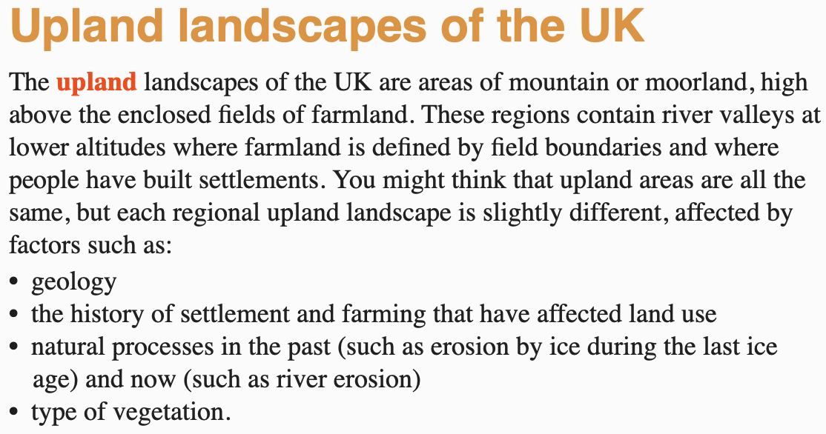
Task:
Using the information in the box and images above, describe what you are likely to find in upland areas of the UK in one sentence.
____________________________________________________________________________________________________________________________________________________________________________________________________________________________________________________________

Slide 6
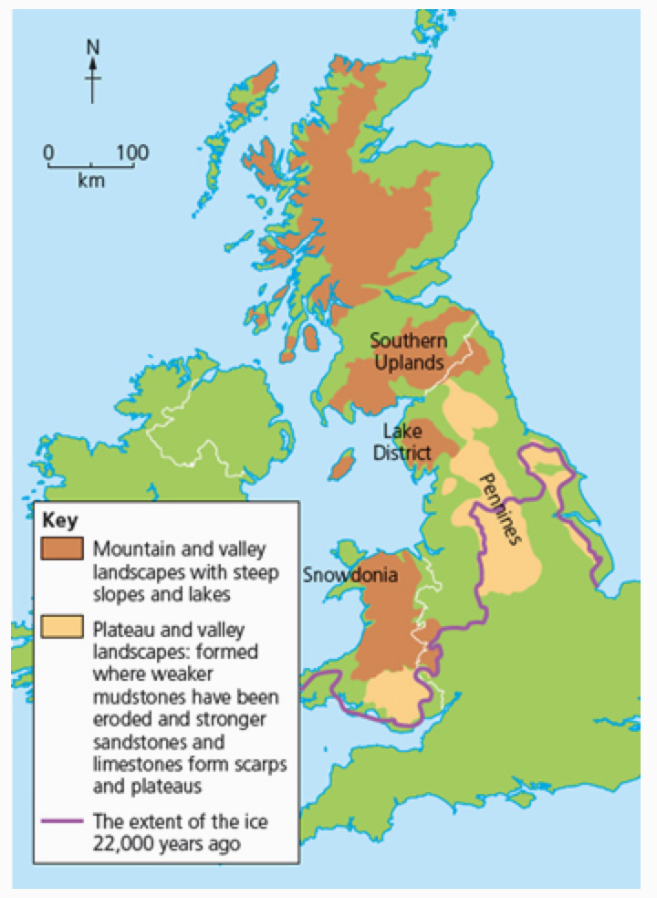
Task
Using the map, describe the distribution of the following:
-Mountain and valley landscapes
-Plateau and valley landscapes
__________________________________________________________________________________________________________________________________________________________________________________________________________________________________________________________________________________________________________________________________________________________________________________________________________________________________________________________________________________________________________________________________________________________________
Clues:
Remember, describe means ’say what you see’
Use compass points and place names to help you locate.
Challenge
What can you tell about the relationship between these landscapes and the extent of the ice?
__________________________________________________________________________________________________________________________________________________________________________________________________________________

Slide 7
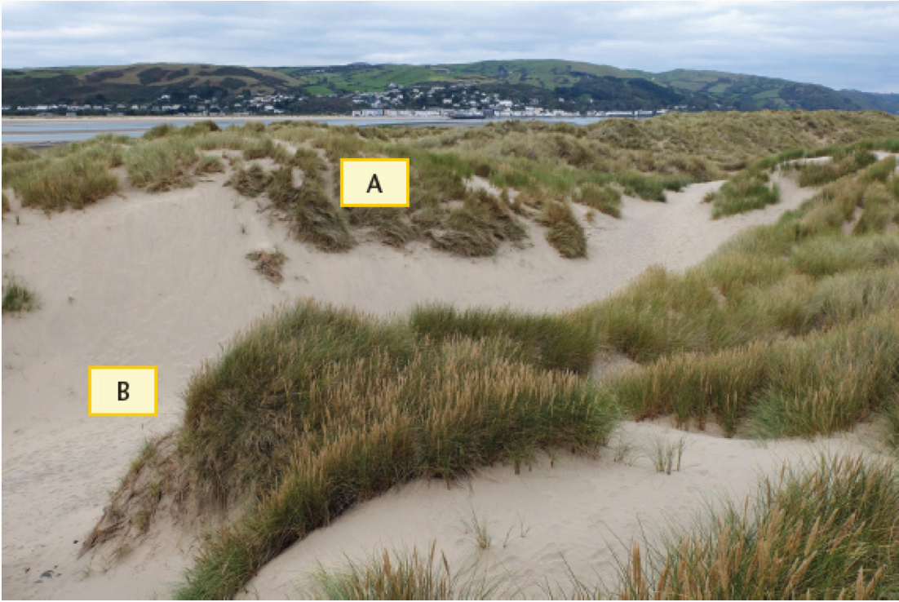
Task
Describe what landscapes you can see on this photograph, specifically at points A and B.
____________________________________________________________________________________________________________________________________________________________________________________________________________________________________________________________________________________________________________________________________________________________________________________________________________________________________________________________________________________________________________________________________________________________________________________________________________________________________________
Clues:
Remember, describe means ’say what you see’
Begin with what you can see in the immediate foreground of the image, then go on to focus on what might be in the background.

Slide 8
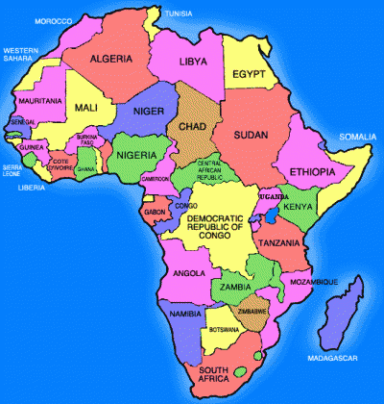
Self mark your work!
Lesson 1:
Recap questions:
Corrie or cove
Oil, natural gas, opium
Constructive, destructive, conservative
See map of Africa
Human development index
Key terms:
Carrying capacity- The ability of a landscape to absorb the activity of people without any lasting damage.
Honeypot sites- Places that attract many tourists and are often congested.
Place- A geographical concept used to describe what makes somewhere special, unique or distinct.
Scale- A geographical concept used to describe the size or area covered by a feature.
Spatial- Patterns or geographical features that vary over two dimensions so that they can be shown on a map.
Upland- A landscape that is hilly or mountainous. Upland landscapes contain large areas of open space with few field boundaries.

Slide 9
Lesson 2: What are honeypot sites?
Task- Think, pair, share
Using the images, think of a definition for the term ‘honeypot site’. Once you have thought of one, write the definition down in your books.
__________________________________________________________________________________________________________________________________________________________________________________________________________________________________________________________________________________________________________________________________________________________________________________________
_______________________________________________________________________________________________________________________________________
Turn to page 13 to self mark!

Slide 10
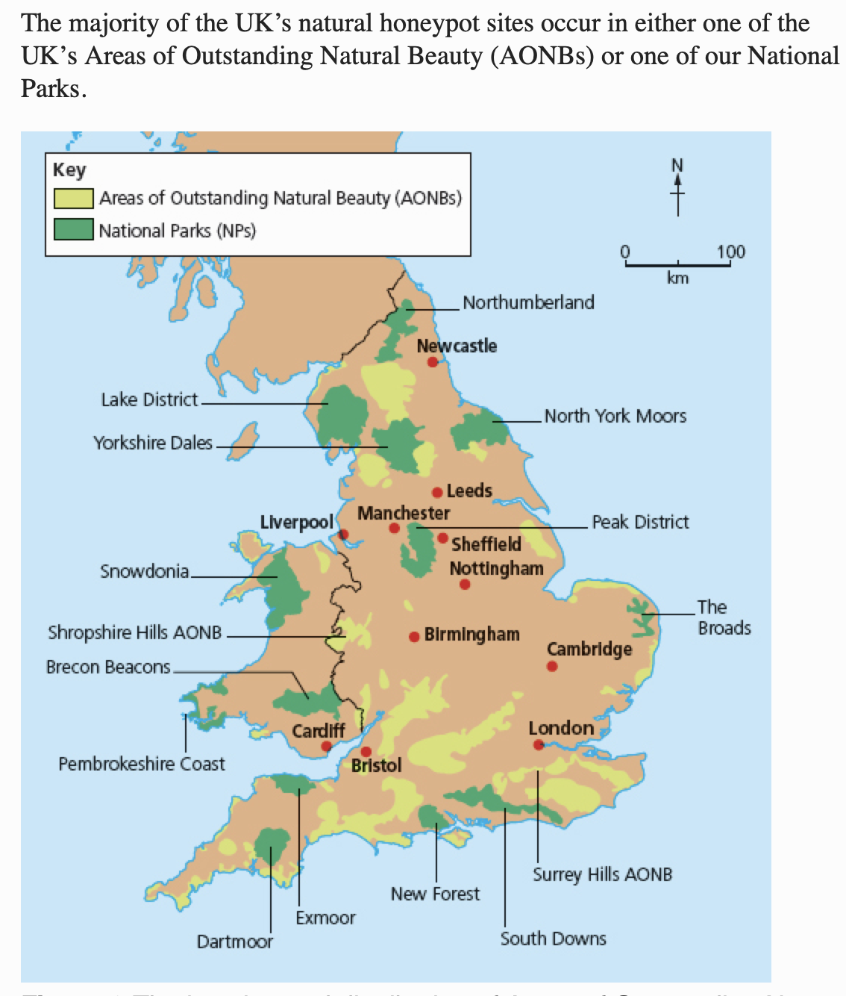
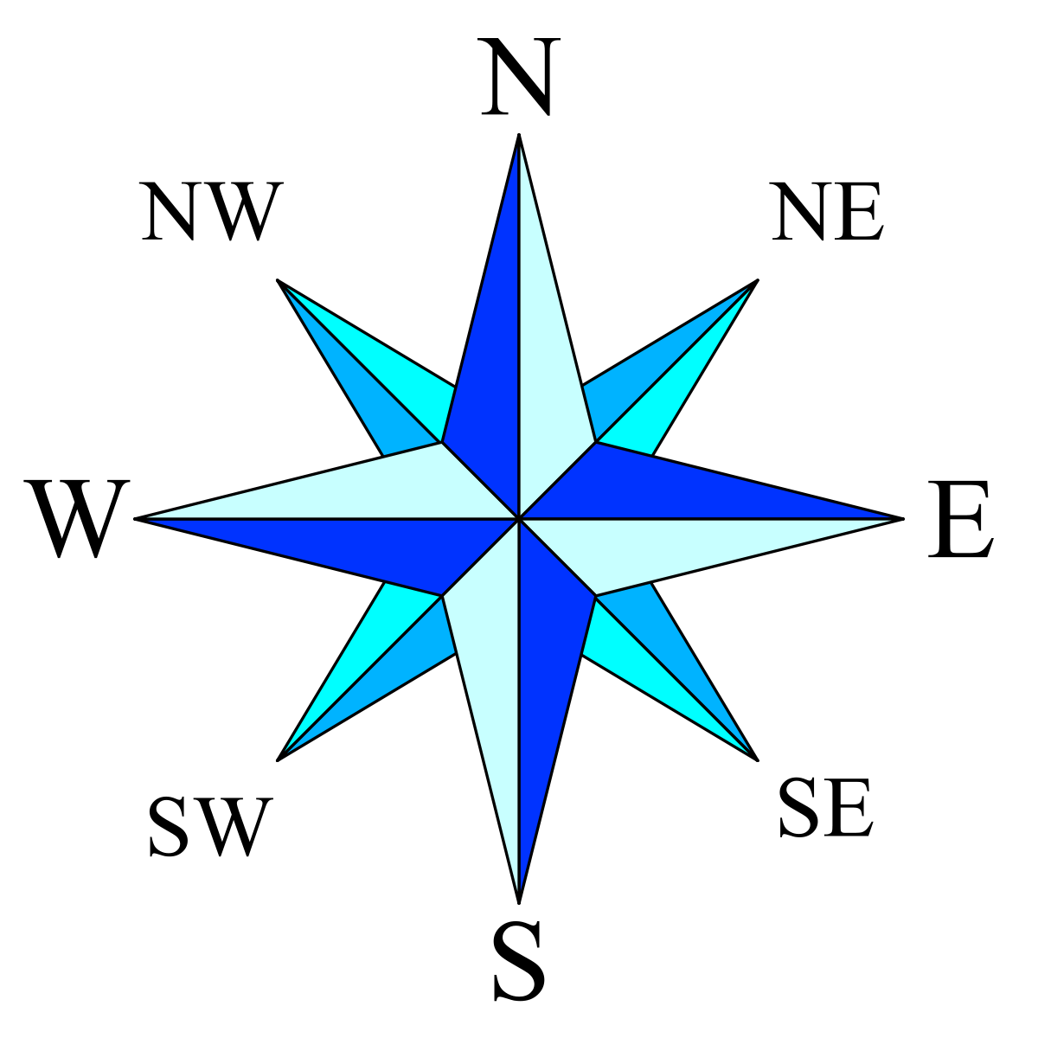
The majority of the UK’s natural honeypot sites occur in either one of the UK’s areas of outstanding natural beauty (AONB) or one of our National parks.
Task
Using the image, text and compass, describe the distribution of AONBs and National Parks.
Use locations and compass directions to help you describe.
__________________________________________________________________________________________________________________________________________________________________________________________________________________________________________________________________________________________________________________________________________________________________________________________
__________________________________________________________________________________________________________________________________________________________________________________________________________________________________________________________________________________________________________________________________________________________________________________________

Slide 11
Task
This image shows Lulworth cove on the Dorset coastline, UK.
Create a spider diagram to show why this area might be considered as a honeypot site. One idea has already been mapped for you.
Lulworth cove receives good weather in the summer
Lulworth cove

Slide 12
Task
Honeypot sites are not always good for their local area.
Using the worksheet, split the statements into positive and negative.
Challenge
Split the statements into social, economic and environmental factors.

Slide 13
Self mark your work!
What are honeypot sites?
Honeypot sites are areas which attract many tourists. They usually contain attractive scenery or historic/culturally significant buildings. These areas are so called because tourists flock to these places like 'bees around honey'.

Slide 14
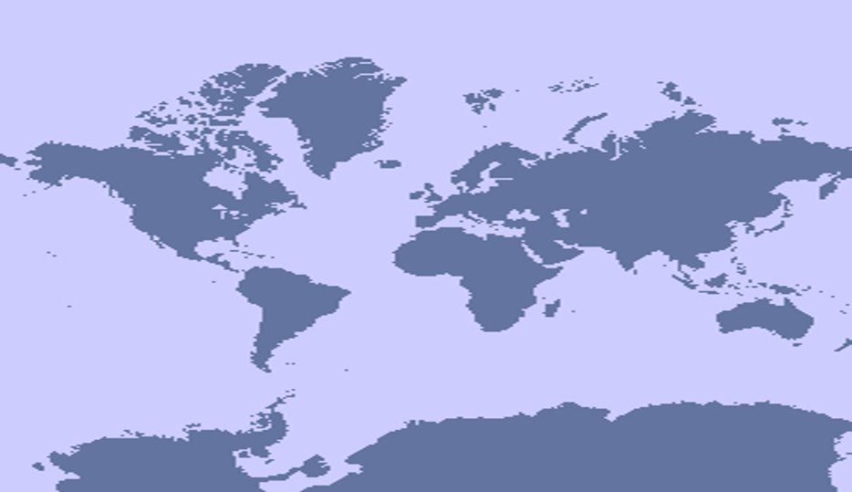
Lesson 3: Introduction to Coasts
Prevailing wind
The size and power of waves is created by the wind. The stronger the wind, the more powerful and larger the wave.
Prevailing wind is a term used to describe the main wind direction to a coastline. In the UK, the prevailing wind is South West, meaning that the wind comes from the south west of the country.
Fetch is a term used to describe how far the wind has travelled. If the wind has travelled further, it is said to have a long fetch, and therefore will be more powerful.
Task:
In your own words, create a definition for ‘prevailing wind’ and ‘fetch’.
Using the map on screen, describe the prevailing wind that the UK receives.
________________________________________________________________________________________________________________________________________________________________________________________________________________________________________________________________________________________________________________________________________________________________________________________________________________________________________________________________________________________________________________________________________________________________________________________________

Slide 15
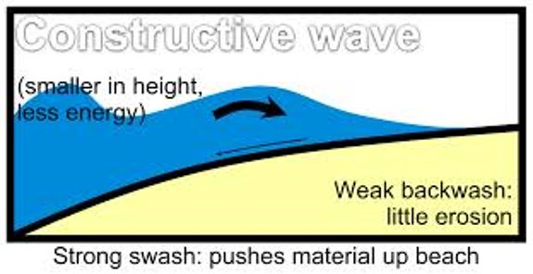
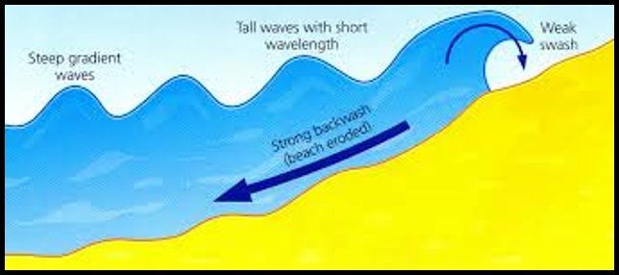
Types of wave
Constructive wave
Destructive wave
Task:
Draw a small diagram of each of these types of waves, adding the labels.
Come up with a definition for each type of wave, then write it down underneath the relevant diagrams.
 | Constructive wave | Destructive wave
Diagram
Definition
Red pen your table using the answers on page 18.

Slide 16
Types of erosion
Task:
Match up the correct type of erosion with its definition, then red pen your answers when finished using page 18
Type of erosion | Definition
Hydraulic action | Rocks are worn away by the acidity of the water.
Abrasion | Rocks crash into each other, making them smoother and rounded.
Attrition | Rocks are launched by the waves at the cliff face to erode it away.
Corrosion | Water forces itself into the cracks in rocks and breaks it away.

Slide 17
Erosion in the UK
Concordant coastline
Discordant coastline
Task:
Using the information, answer the following question:
“Describe the difference between concordant and discordant coastlines. (4 marks)”
______________________________________________________________________________________________________________________________________________________________________________________________________________________________________________________________________________________________________________________________
_______________________________________________________________________________________________________________________________________________________________
_______________________________________________________________________________________________________________________________________________________________
_______________________________________________________________________________________________________________________________________________________________
Check your answer on page 18

Slide 18
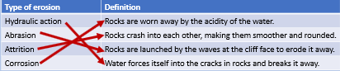
Self mark your work!
Constructive wave
Destructive wave
They are created in calm weather and are less powerful than destructive waves. ​
They have a swash that is stronger than the backwash.
They break on the shore and deposit material, building up beaches.​
They have a long wavelength, and are low in height​
They are created from big, strong waves when the wind is powerful and has been blowing for a long time (long fetch). ​
They have a short wavelength and are high and steep .
They have a stronger backwash than swash. ​
They tend to erode the coast
These waves are created in storm conditions. ​
Types of erosion
Model 4-mark answer
Concordant coastlines contain bands of hard and soft rock, running parallel to the coast. (1)
This means that erosion happens at a uniform rate, creating an even coastline. (1)
Discordant coastlines alternative bands of hard and soft rock, at a perpendicular angle. (1)
This means that erosion happens at different rates, creating headlands and bays. (1)

Slide 19


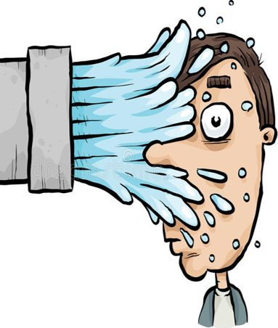

Lesson 4: Erosion on a discordant coastline
Task:
Using the 4 images, describe which type of erosion each image is showing and why you think this.
Remember, the 4 types of erosion are hydraulic action, abrasion, attrition and corrosion.
Image 1 is ________________. I think this because ______________ ________________________________________________________________________________________________________________
Image 2 is ________________. I think this because ______________ ________________________________________________________________________________________________________________
Image 3 is ________________. I think this because ______________ ________________________________________________________________________________________________________________
Image 4 is ________________. I think this because ______________ ________________________________________________________________________________________________________________

Slide 20
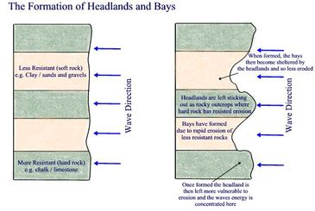
Task:
Using the diagram on screen, write a step by step process as to how headlands and bays are created.
Make sure you include the following key terms: ‘hard rock, soft rock, headland, bay, beach, erosion, wave action.’
__________________________________________________________________________________________________________________________________________________________________________________________________________________________________________________________________________________________________________________________________________________________________________________________
_____________________________________________________________________________________________________________________________________________________________________________________________
_____________________________________________________________________________________________________________________________________________________________________________________________
_____________________________________________________________________________________________________________________________________________________________________________________________
_______________________________________________________________

Slide 21
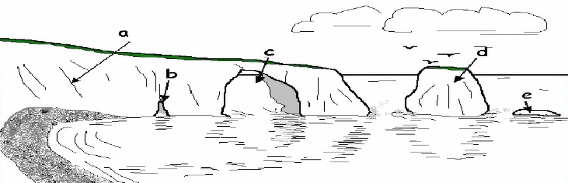
Erosion of the headland
Task: Match the terms in red with the gaps in sentences
Large ________ form due to the processes of ___________________ and ________, meaning that the waves and the rocks picked up by the water force their way in and break pieces of ______ away.
rock, hydraulic action, cracks, abrasion.
A
Through continued __________ , the _______ in the rock opens into a _______. These are often _______ in size and allow further erosion to take place ________ the headland.
erosion, inside, cave, large, crack.
B
Further ________ inside the cave leads to more ______ crumbling away. This eventually breaks through the other side of the ___________, leaving a feature called an _____.
headland, rock, arch, erosion.
C
Eventually, the _______ collapses as more _______ takes place at the _______ of the headland. This leaves a disconnected piece of land, which is called a _______.
stack, arch, base, erosion.
D
___________ continues to take place on the _______, eventually leading to it crumbling and __________, creating a feature called a _______.
collapsing, Erosion, stack, stump.
E

Slide 22
GCSE Question
Using the image, explain the process that leads to the erosion of resistant rock in a headland. (4 marks)
________________________________________________________________________________________________________________________________________________________________________________________________________________________________________________________________________________________________________________________________________________________________________________________________________________________________________________________________________________________________________________________
____________________________________________________________________________________________________________________________________________________________________________________________________________________________________________________________
_____________________________________________________________________________________________________________________________________________________________________________________________

Slide 23
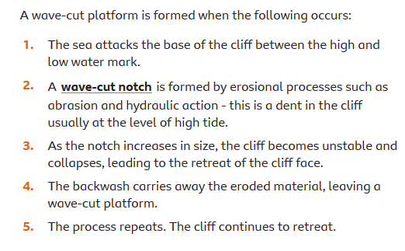
Lesson 5: Erosion on a concordant coastline
There are 2 types of wave cut landforms that occur on concordant coastlines. These are:
Wave cut notches
Wave cut platforms
Read the information, then turn to the next page for your tasks!

Slide 24
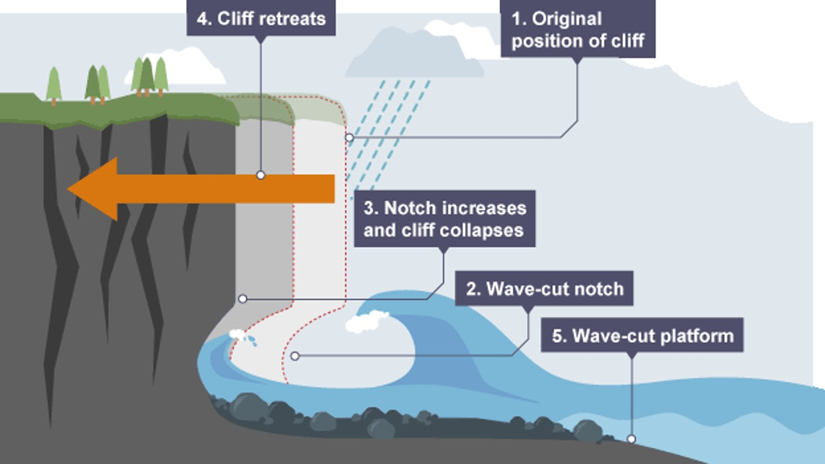
Task:
Label your diagrams using the key terms.
Key terms:
Wave cut notch
Wave cut platform
Original position of cliff
Cliff retreats
Notch increases and cliff collapses
Challenge:
Why does this type of erosion not take place on a discordant coastline?
__________________________________________________________________________________________________________________________________________________________________________________________________________________________________________________________________________________________________________________

Slide 25
GCSE Question
Explain how erosional processes differ on concordant and discordant coastlines (6 marks)
______________________________________________________________________________________________________________________________________________________________________________________________________________________________________________________________________________________________________________________________________________________________________________________________________________________________________________________________________________________________________________________________________________________________________________________________________________________________________________________
___________________________________________________________________________________________________________________________________________________________________________________________________________________________________________________________________________________________________________________________
Turn to page 26 to self mark!

Slide 26
Self mark your work!
GCSE model answer
On concordant coastlines, bands of uniform rock mean that erosion takes place at the same rate. (1)
This leads to the formation of wave cut platforms (1)
This happens when waves erode the base of a cliff, creating a wave cut notch and causing the cliff to collapse and retreat. (1)
On discordant coastlines, erosion takes place at different rates because of the perpendicular bands of hard and soft rock. (1)
Soft rock erodes to create bays. (1)
Hard rock forms headlands, which erode more slowly, creating caves, arches, stacks and stumps. (1)
Well done- this booklet is now completed. The next booklet will contain:
-Coasts (pt 2)
-An introduction to Rivers

