Slide 1
Safety in a Lab

Slide 2
Learning Objective
To be able to explain how to be safe in a lab and recall some common hazard symbols and lab rules.
Success Criteria
To identify some important safety rules in a lab.
To recall and identify hazard symbols.
To explain how to keep yourself safe in a lab, especially during practicals.

Slide 3
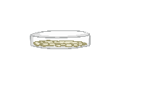
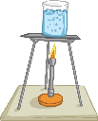
Laboratory Hazards
From the picture below, identify any hazards in the lab.
Work together as a table to come up with the hazards.
Extension: Could you suggest any precautions the children could take to make the lab safer?

Slide 4
Laboratory Hazards Answers
1. running
2. eating
3. sitting down during a practical
4. bags on the desk
5. coats on the desk
6. no goggles on
7. unattended practical
8. untied hair
9. putting glass in the bin

Slide 5
Why Is Safety so Important?
What do you use a laboratory for and why is safety so important?
Discuss with your table – you have two minutes to come up with an answer.
A Science laboratory is used for carrying out practical investigations. They involve using dangerous chemicals and practical equipment such as Bunsen burners.
Some practical equipment, such as test tubes, are easily breakable so care must be taken.
The safety of both pupils and teachers is very important so that no one gets hurt.

Slide 6
Hazard Symbols
What do you think the following hazard symbols show?
Notes:
Higher Ability

Slide 7
Hazard Symbols
What do you think the following hazard symbols show?
flammable
corrosive
toxic
explosive
You might sometimes see this symbol instead of the symbol for health hazard. It means harmful or irritant.
health hazard
hazardous to the environment

Slide 8
Hazard Symbols
Why are hazard symbols so important? Write down your answers on a whiteboard and hold them up.
You have 2 minutes.
They show people how dangerous a chemical is, and what care should be taken when handling them.
Symbols can be used all over the world and are immediately recognisable, so it doesn’t matter which language is used.
Extension:
Why use symbols?

Slide 9
Hazard Symbols in the Lab
What hazard symbols can you find around the laboratory? Go around the room and list all of the chemicals you can find.
Chemical | Hazard Symbol
hydrochloric acid | corrosive
Extension:
Have you heard of any of these chemicals? Do you know anything about them?

Slide 10
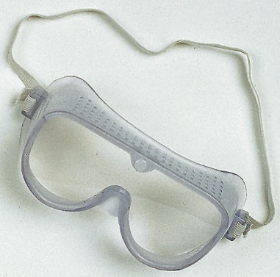
Rules in the Lab
From the diagrams below, work out what the rules are.
Which rule do you think is the most important in a lab? Put them in order from most important to least.
Explain to the person next to you why you have put them in this order.
Extension:
Can you add your own rules that are not on here?
Image courtesy of flickr.com @(/photos/epicfireworks/3697349618)

Slide 11
Rules in the Lab
Neatly, list 5 of the most important rules in the front of your book.

Slide 12
Problem-Solving
Read the scenarios and explain what the teacher/student should do.
You spill a chemical on the desk during a practical. What should you do?
You notice a bag in the middle of the floor. What should you do?
Your teacher notices a student sitting down at the desk during a practical. What should they do? Why?
You feel hungry during a practical. What should you do about it?
You drop a glass beaker on the floor during a practical. What should you do?
Tell your teacher. Clear it up if they tell you to do so.
Move the bag to either a bag storage area or place under the desk.
Ask the pupil to stand up and push their chair under, so if there is a spillage, the pupil can move away more easily.
Nothing – wait until the lesson has finished (break/lunch).
Tell your teacher. They will brush it up and place it in a glass bin.

Slide 13
Hazard Symbols Quiz
Check the Learning
a) toxic
b) flammable
c) irritant

Slide 14
Hazard Symbols Quiz
Check the Learning
a) toxic
b) flammable
c) corrosive

Slide 15
Hazard Symbols Quiz
Check the Learning
a) harmful
b) flammable
c) corrosive

Slide 16
Hazard Symbols Quiz
Check the Learning
a) health hazard
b) flammable
c) explosive

Slide 17
Hazard Symbols Quiz
Check the Learning
a) harmful
b) explosive
c) flammable

Slide 18
Hazard Symbols Quiz
Check the Learning
a) hazardous to the environment
b) flammable
c) explosive

Slide 19
Photo courtesy of (@flickr.com) - granted under creative commons licence - attribution

